Slide 1
Be a Geo-Mentor or a Trainer for GIS
presented by
Judith K. Bock – judy@thinkgeospatial.education
Jenni Dahl - jenni@thinkgeospatial.education
Geospatial Education Consultants

Slide 2
Goals for this session
Share information about GIS mentoring
Who the geospatial community in IL is
Why mentors are needed for K-12 education
What you might do as a mentor for K-12 education
How you can become a mentor
for Esri GeoMentor Program
for ILGISA Professional Network
for K-12 Illinois Geospatial Education
Action App ArcGIS Online
Climate Change Community
ConnectED Demography
Education Esri Free
Geography GIS GIS Day
GIS for Holidays Google
GPS History iPhone Labor Day
Mapping NMOS
Projections Resources Surveying
Videos Websites Workshops

Slide 3
The Illinois Community for Geospatial Education

Slide 4
Why mentors are needed more than ever . . .
Free Esri K-12 GIS license for organizational accounts: ArcGIS Online and ArcGIS Desktop
State K-12 GIS License
ConnectED
Teachers are not trained
in geospatial skills or analysis
for integrating spatial interactions and connections to curriculum
GeoEd community needs help

Slide 5
The Esri K-12 Licenses
Illinois State License
ConnectED
Formal and informal education
K-12 only
Organizational account
ArcMap Desktop
ArcGIS Online (for informal groups)
Hosted by IVS
Supported by the ISBE and IGGIE
K-12 public and private education
Organizational account
ArcGIS Online
(Contacts State License group for ArcMap Desktop access)
Hosted by ESRI
Supported by K-12 License Team and IGGIE

Slide 6
ArcGIS Online
ArcGIS Online: http://www.arcgis.com/home/
Features
Spatial analysis capabilities
Presentation mode
Arc Story Maps: http://storymaps.arcgis.com/en/
Story maps
Esri Education Community: http://edcommunity.esri.com/
Lesson Plans: http://edcommunity.esri.com/Resources/ArcLessons

Slide 7
A Geo-Mentor
http://esrik-12gis.emich.edu/k12/images/articles/tu3.png
GIS professionals who help educators and
students learn to use GIS.
is a volunteer
supports educators as they work through instructional materials to learn GIS skills
helps a teacher or youth club leader learn analytical strategies and ideas for applying GIS
guides spatial and geographic thinking
outlines field work projects for problem-solving and decision-making using GIS layers
provides materials, maps, tools for classroom use

Slide 8
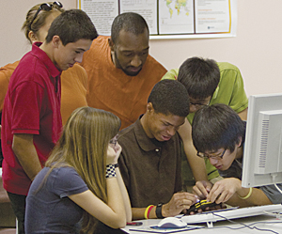
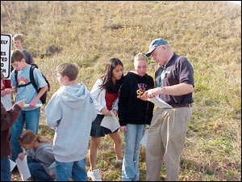
A GeoMentor . . .
http://www.esri.com/news/arcnews/
summer10articles/summer10gifs/p42p2.jpg
http://www.esri.com/news/arcnews/
winter0405articles/winter0405gifs/p43p3.jpg
is anyone who
includes
uses geography and/or GIS
recognizes the ways in which geography matters to us all
has an interest in helping young people
users of GIS
mapmakers
city and regional planners
local government workers
utility industry workers
transportation people
health care staff and social workers
architects and engineers
farmers, foresters, and fishermen
safety and security people
homemakers
anyone who recognizes that where things are and
how they relate to other things influences our lives

Slide 9
Location, location, location . . .
Geo-mentors are needed throughout the entire state
work in local area
may be asked to train a group in a school or learning center
can work remotely with a teacher or class via school-sanctioned email
http://www.iandrinstitute.org/j0189593[1].jpg

Slide 10
What Geo-Mentors do . . .
Whatever is needed to help advance GIS in the K-12 curriculum or in informal education, for example . . .
Host a training workshop for basic GIS (ArcGIS Online) skills
Work one-on-one with a teacher to develop a GIS project, explain how to use GIS in the project
Connect with a teacher to answer questions about GIS
Do a presentation about your GIS specialty to a class

Slide 11
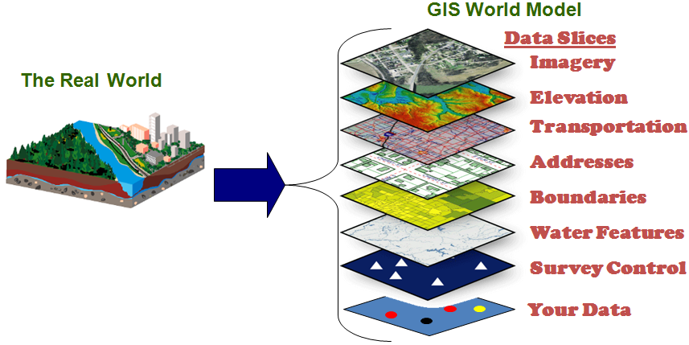
What is GIS?

Slide 12
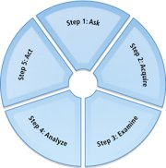
The Geographic Approach
Geography is the science of our world.
The Geographic Approach—a new way of thinking and problem solving that integrates geographic information into how we understand and manage our planet.
Step 1: Ask – Frame a question
Step 2: Acquire – Find data
Step 3: Examine – Examine and
organize the data
Step 4: Analyze – Investigate,
evaluate, question
Step 5: Act – Solve problems,
make decisions, share the results

Slide 13
Geo-Mentor Skills . . .
http://blogmilitaryfamily.files.wordpress.com/2014/02/mentor.jpg
Vision –Understanding geography helps people make good decisions. Geo-Mentors must be able to share their experience in geographic thinking to foster such growth for others.
Commitment – Being a Geo-Mentor means sharing capacity over multiple sessions. This is a relationship. Successful mentoring is a partnership, which takes time.
Willingness to Learn & Share – Mentoring means understanding. Mentors must listen and observe enough to know "What does this educator need?" Mentors need to talk with the educator and learn what will help.
Excitement – Mentors must be excited, remembering the thrill of early maps, the glee of GPS dots appearing within a GIS display, the fascination in a local aerial photo. Recreate that for someone, and experience it all over again!

Slide 14
Real experiences in a real classroom
In 2001 Springfield High School (SHS) introduced a GIS course as a social studies elective. The GIS class started with a 3-4 computers and grew to have 20 computers with ArcMap installed. The class acquired the ArcMap license through an Esri Community Atlas grant. The students used the Mapping Our World curriculum and supplemented the curriculum with projects. The projects added depth and meaning to the course. These special projects wouldn’t have been possible without Geo-Mentors. The next few slides describe ways Geo-Mentors provided guidance and resources to the class.
https://fbexternal-a.akamaihd.net/safe_image.php?d=AQCOJC-M7E3Af08f&w=395&h=660&url=
http%3A%2F%2Fupload.wikimedia.org%2Fwikipedia%2Fen%2Fa%2Fad%2FSpringfield-High-Logo-and-School.png

Slide 15
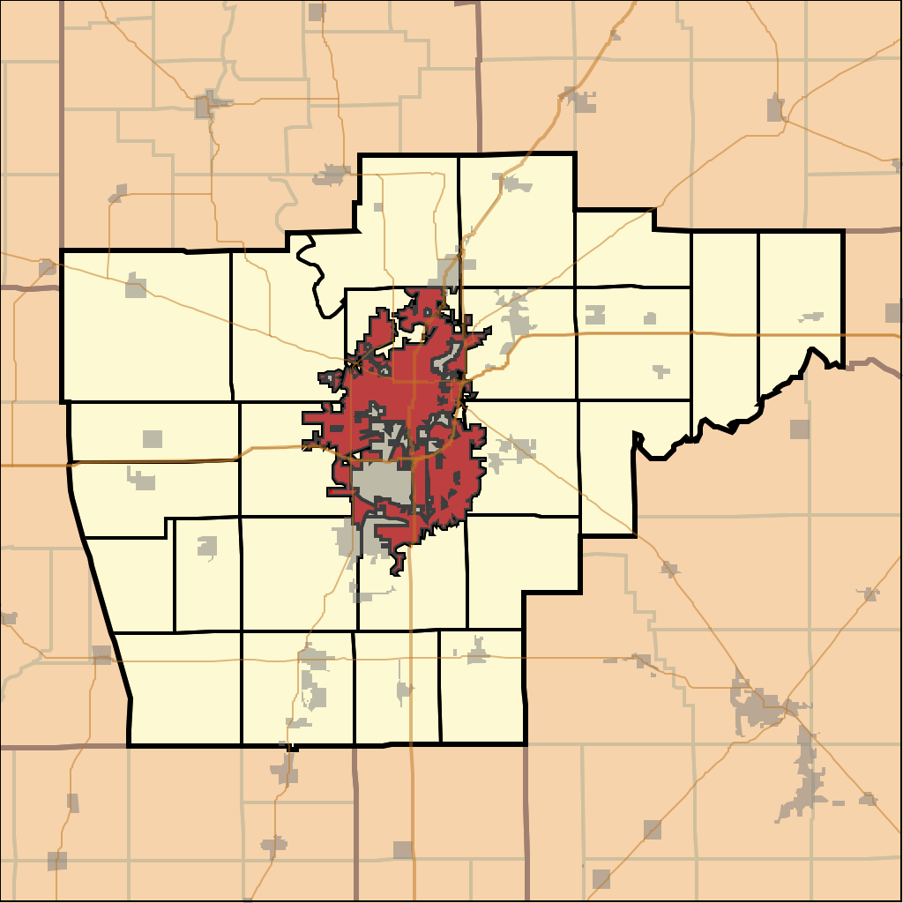
Real experiences in a real classroom
SHS GIS Class Geo-Mentors included:
City of Springfield GIS Professionals
Guest speakers
Internship opportunities
Information about how to acquire local data
Field trip to see city GIS facilities
GIS Consulting Business employees/owner
Donated plotter
Internship opportunities
http://upload.wikimedia.org/wikipedia/commons/thumb/3/3a/Map_highlighting_
Capital_Township,_Sangamon_County,_Illinois.svg/1024px-Map_highlighting_Capital_
Township,_Sangamon_County,_Illinois.svg.png

Slide 16
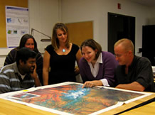
Real experiences in a real classroom
SHS GIS Class Geo-Mentors included:
ILGISA members
Offered the opportunity to display a poster at a conference
County GIS Professionals
Information about how to
acquire local data
Guest speaker
Advise and guidance in projects
http://www.uis.edu/gis/wp-content/uploads/sites/52/2013/03/project3.jpg

Slide 17
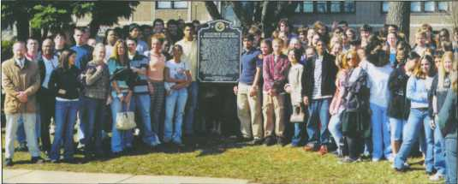
Real experiences in a real classroom
http://www.lib.niu.edu/2005/ih050507-3.jpg
SHS GIS Class Geo-Mentors included:
Illinois State Historical Society, Director, Interns and Board members
Project ideas
Support and guidance
List of coordinates of historical markers for project
Intern assigned to help students with project
Guest speakers
Invitations to present at Historical Society Symposium

Slide 18
Real experiences in a real classroom
How did the SHS GIS Class find Geo-Mentors?
The students met local GIS professionals at the ILGISA conference who were willing to help.
Some of the Geo-Mentors were parents of GIS class students.
The Director of the Historical Society brought a GIS project idea to a District 186 instructional leader and was directed to the SHS GIS class.
The students found contact information for GIS professionals at the city and county and called them.

Slide 19
What Geo-Mentors do . . .
PROVIDE
Provide local maps at a range of scales to put on the wall.
Print a big wall map on 8.5 x 11-inch pages for the group to piece together
Provide classroom subscriptions to publications like National Geographic.
Provide the school/group with a GPS device.
Provide local GIS data.
Plot maps created by the school/group.
Help the school/group acquire ArcGIS Online or ArcMap and get it running.

Slide 20
What Geo-Mentors do . . .
LEAD
Lead a very local field trip (around the building or neighborhood) building a simple database of mappable data.
Bring in a GeoCareers event that highlights careers, engaging geography, and/or highlights GIS Day.
Lead an educator through the intro documents in Esri’s Educator Portal.
Help an educator get started in Esri's ArcGIS Online SkillBuilder document.
Help an educator get underway in Esri's online Teaching with GIS class.

Slide 21
What Geo-Mentors do . . .
TEACH
Teach how to create and use a good data table with latitude/longitude or addresses and other mappable data.
Guide a mapmaker into understanding and following good cartographic principles.
Show how to use a GPS app on a smart phone to gather data, export a GPX file, and map it.
Show how to make maps online via National Geographic’s MapMaker Interactive.
Show how to construct a story map app via Esri’s StoryMaps.

Slide 22
What Geo-Mentors do . . .
SUPPORT
Sponsor a local or regional map competition.
Help establish a geography or GIS club.
Help at a youth geo event, such as a GeoBee.
Bring the class or youth group on a field trip to your work site.
Help an educator get to a professional development event – workshop, conference, EdUC.
Provide an internship for youth or for an educator.
Assist in writing or pitching grants for tools, materials, training, and activities.

Slide 23
Esri’s GeoMentor Program
http://www.nationalgeomatics.com/graphics/geomentor_logo_x.jpg
The GeoMentoring Program was announced by its co-sponsors, the National Geographic Society (NGS) and ESRI, on July 13, 2009, at the Plenary Session of ESRI’s 29th Annual International User Conference.
A key part of the program is the GeoMentor Website, which has tools for
seeking a (teacher) partner
finding activities
acquiring resources
sharing stories
Place yourself on the Esri GeoMentor Map; find a teacher in your region on the map who is looking for help.
http://edgis.org/storymaps/usk12gis/
http://edcommunity.esri.com/educational-roles/GeoMentors

Slide 24
ILGISA Professional Network (IPN)
Still in proposal format
ILGISA Website for connecting with other GISP and educators
http://2.gravatar.com/avatar/e8bfc690011c88832d9df667439f3289?s=256&d=identicon&r=G

Slide 25
Illinois State K-12 License
Help a teacher or a school get started with GIS –
Complete the sign up for being a mentor
Identify your strengths, how you would like to help
Let us know where you live
Provide contact information
As needs arise, we will match teachers with GIS professionals for training.
We may call on your for GIS support.
We will keep our eyes and ears open for schools/classrooms looking for GIS and/or career speakers.
http://thinkgeospatial.education

Slide 26
Coming Up . . .
http://3.bp.blogspot.com/-UcQBJMGSQ3Q/Tud3_q0q5HI/
AAAAAAAAByw/G1kDzyFctKI/s1600/Mentor-thumb.jpg
ILGISA’s Annual Conference
Bring/sponsor a teacher for the Teacher Workshop Day
Talk with a teacher who is attending
GIS Day
Nov. 19th - "The Future of Food"
Give a presentation about how GIS is used to monitor agricultural production or identify health risks (obesity) or about food desserts
Geography Awareness Week
November 16th - 22nd
Give a presentation at a school
Do a mapping exercise with a scouting group (yes, they have badges for that!)

Slide 27
Remember . . .
you can always connect to be a Geo-Mentor:
thinkgeospatial.education
http://www.eagle.co.nz/SiteAssets/Public/1411/GISDAY-379x132.jpg

